Slide 1
Council Records: A guideline for mayors, councillors, CEOs and council employees
Josephine Marsh
Director, Government Records and Discovery
Queensland State Archives
25 July 2019

Slide 2
An overview of Queensland State Archives
Public Records Act 2002
Covers all public authorities including Councils
Provides access to records
Policies, standards & advice
Disposal authorisation

Slide 3
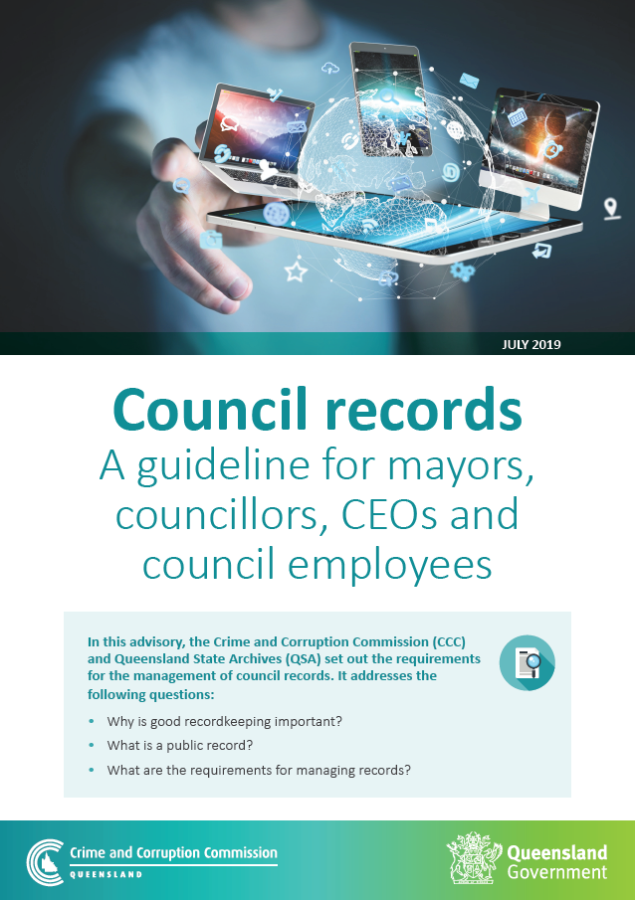
Why is good recordkeeping important?
What is a public record?
What are the requirements for managing records?

Slide 4
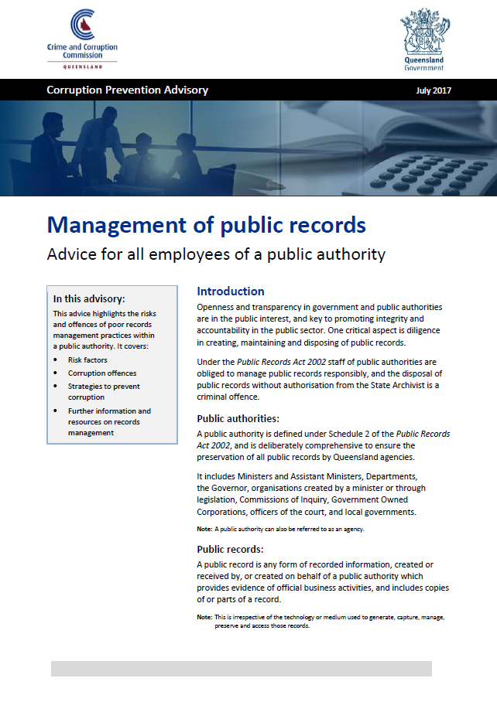
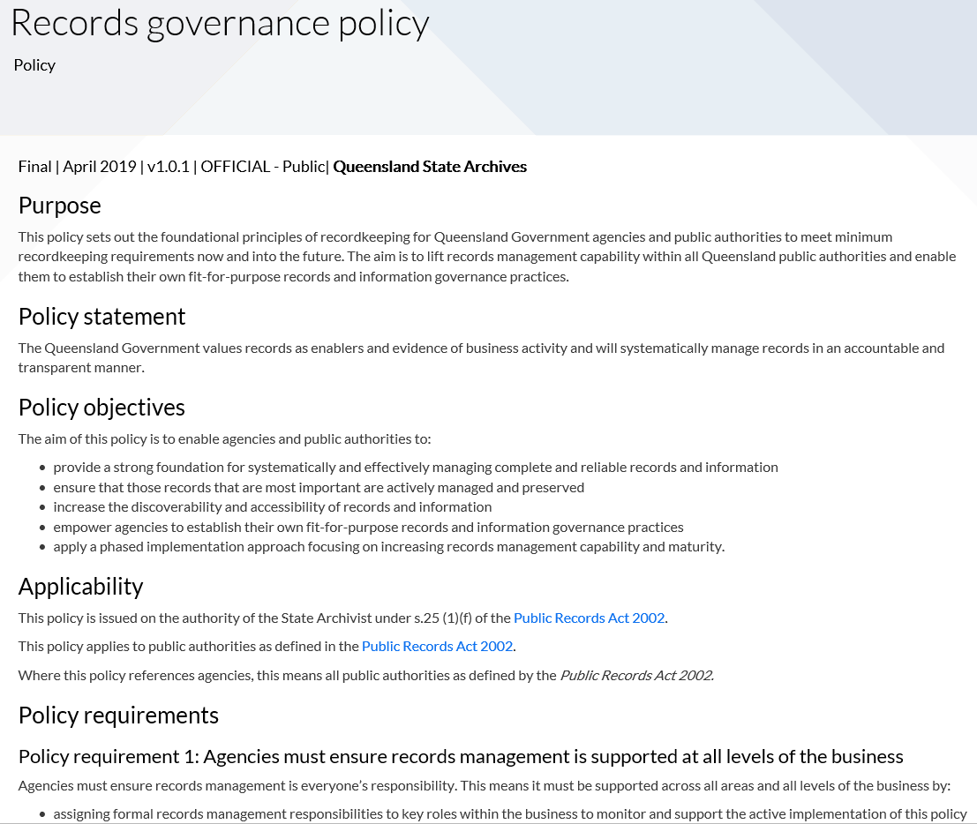
Recordkeeping advice for local government
Records Governance Policy
General recordkeeping advice - https://www.forgov.qld.gov.au/recordkeeping
Corruption Prevention Advisories - http://www.ccc.qld.gov.au/corruption-prevention/corruption-prevention-advisories

Slide 5
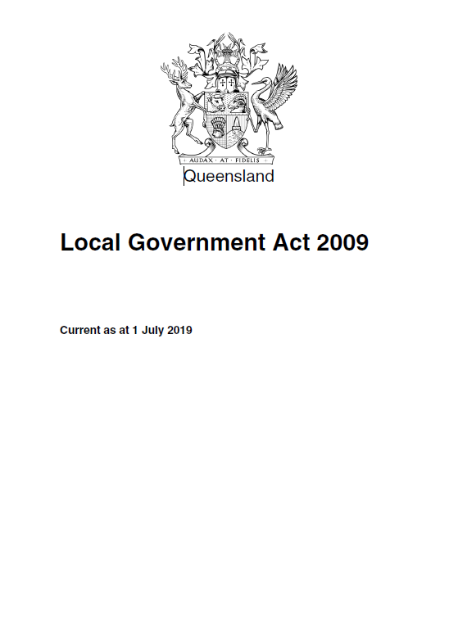
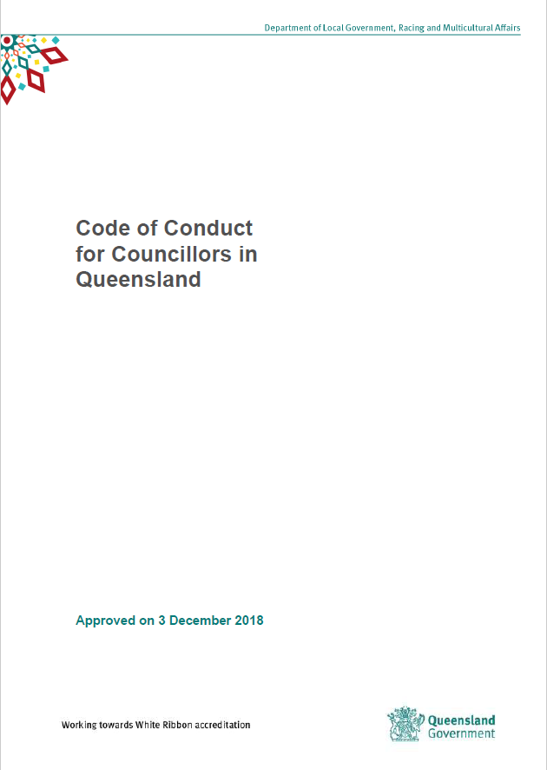
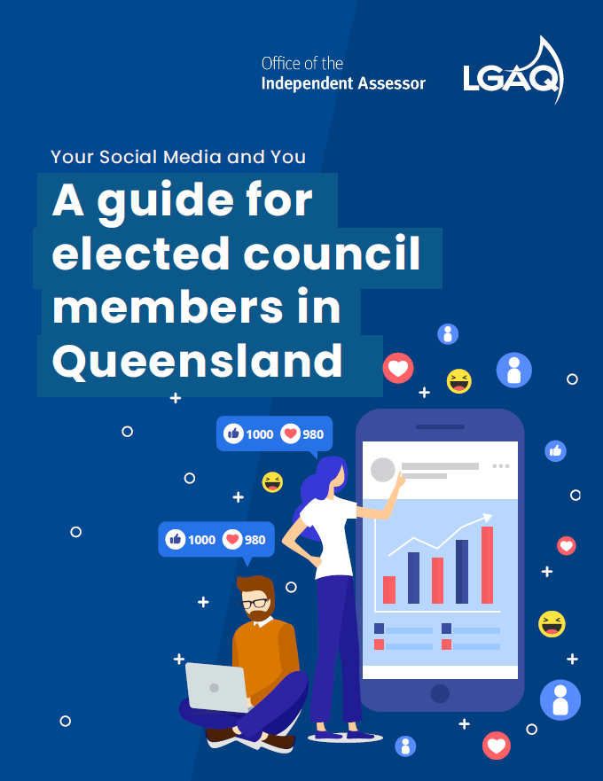
Local Government Act 2009
Code of Conduct for Councillors in Queensland
Your social media and you: A guide for elected council members in Queensland

Slide 6
Why is good recordkeeping important?
Strengthens transparency and good governance
Provide evidence of decisions and actions
Reduce risk of misconduct
Meet legislative obligations

Slide 7
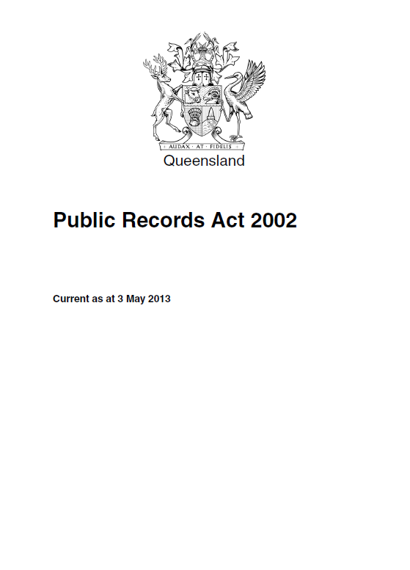
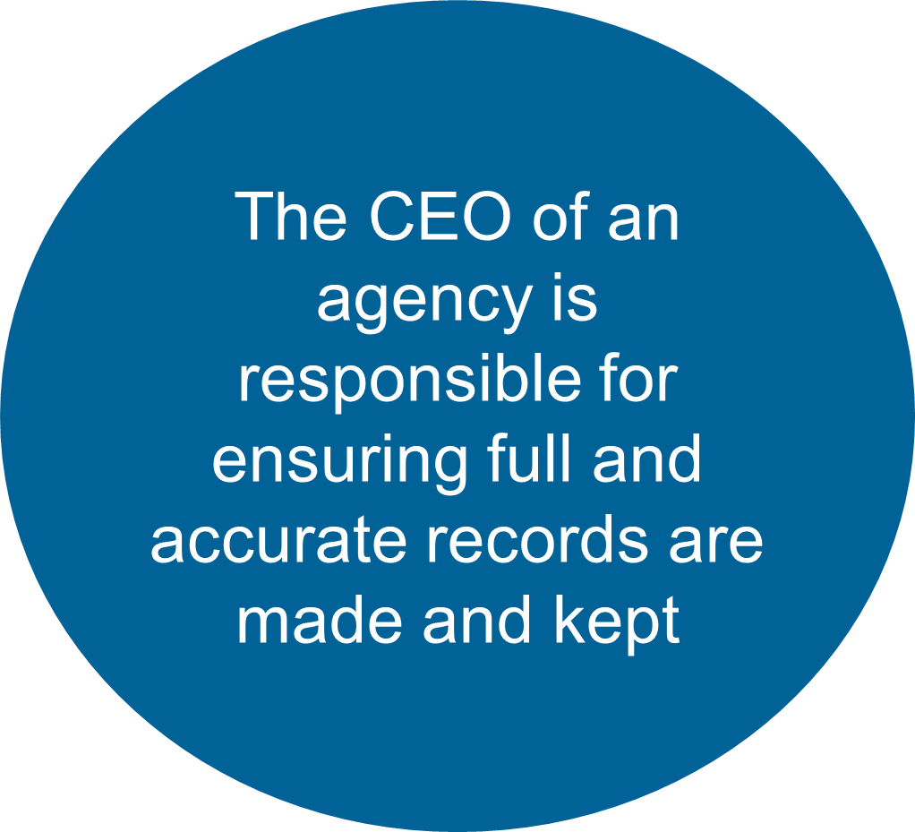

Slide 8
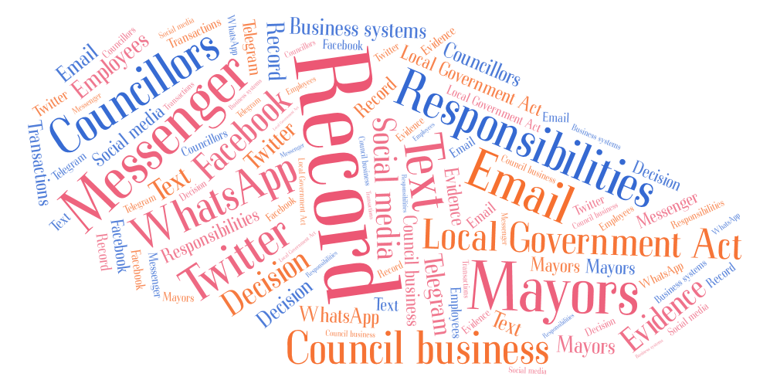
What is a public record?

Slide 9
What are the requirements for managing public records?
Council employees, mayors and councillors are aware of and fulfil their recordkeeping obligations
Council employees, mayors and councillors must make full and accurate public records
Public records must be retained for as long as they are lawfully required to be kept

Slide 10
Stay informed
Subscribe to:
CCC updates
QSA newsletter
Blogs on QSA’s Records Connect
Follow us on:
Twitter
@CCC_QLD
@QSA4gov

Slide 11
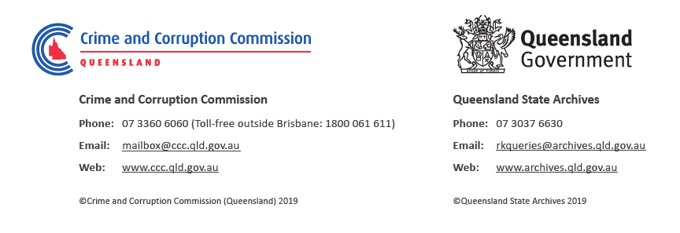
Questions?

